Slide 1
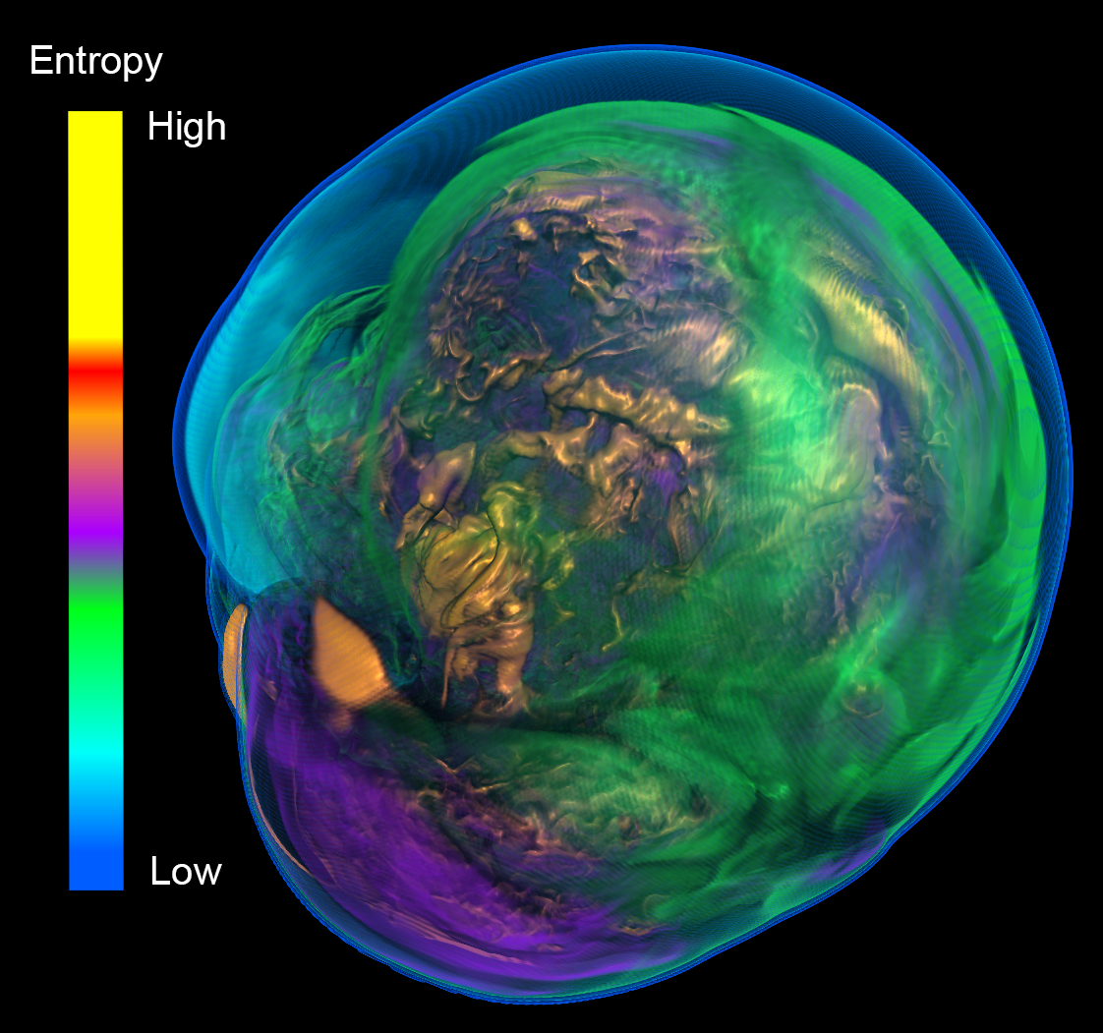
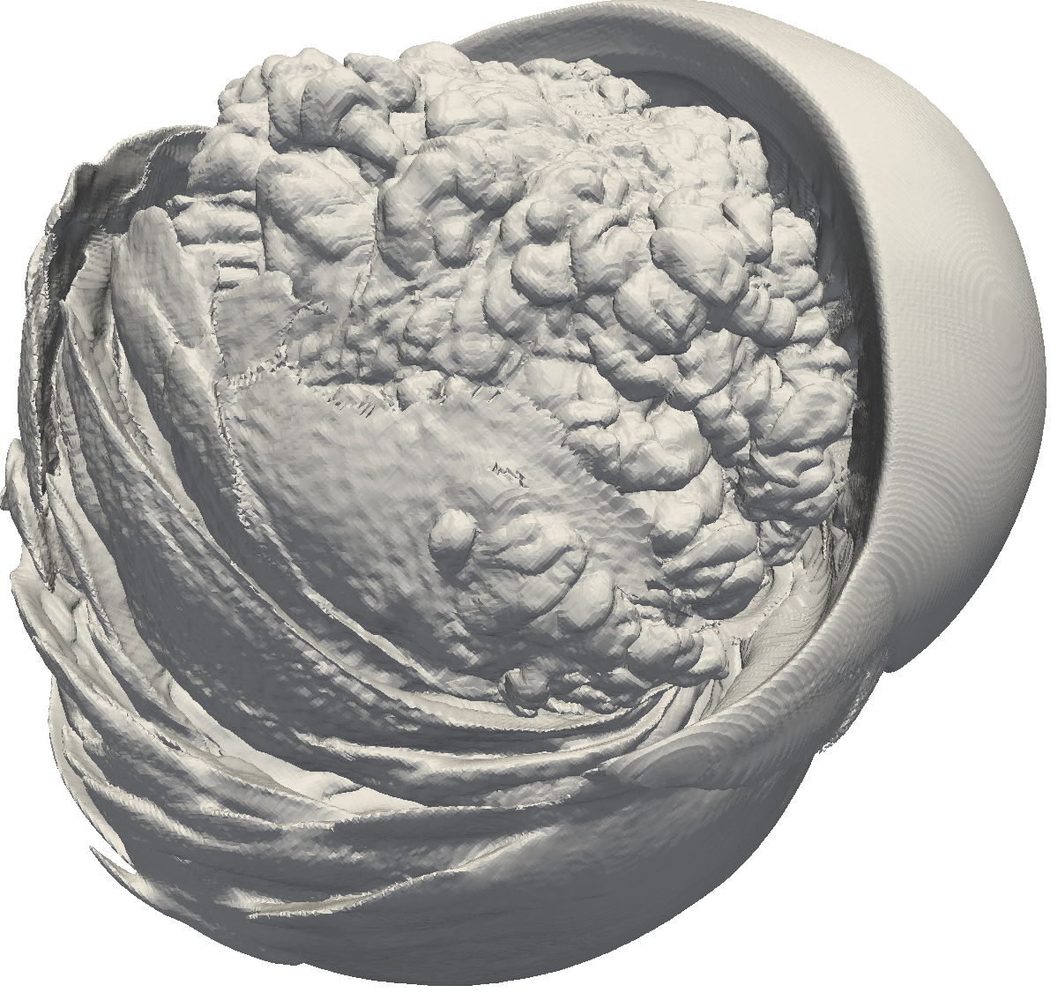
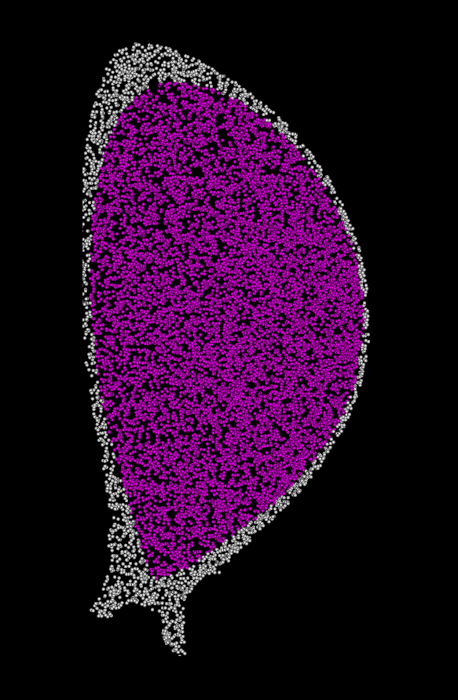
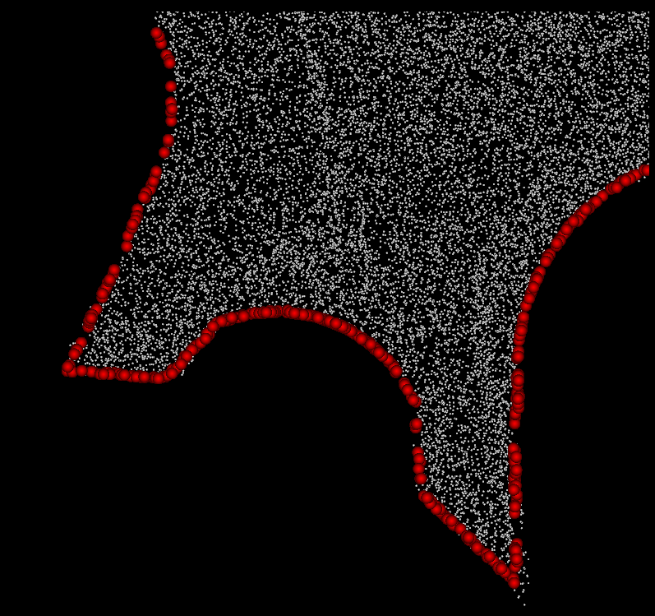
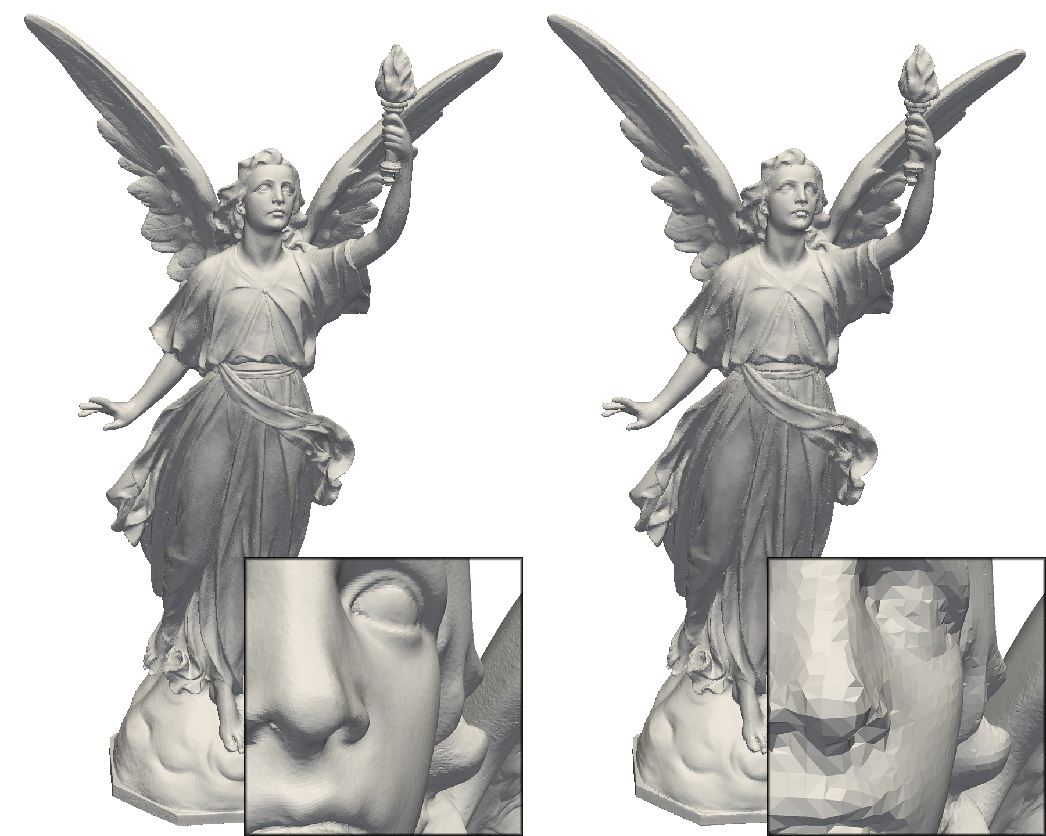
VTK-m
DOECGF 2016
Kenneth Moreland Sandia National Laboratories
with many contributors
April 26, 2016

Slide 2


Acknowledgements
This material is based upon work supported by the U.S. Department of Energy, Office of Science, Office of Advanced Scientific Computing Research, under Award Numbers 10-014707, 12-015215, and 14-017566.
Sandia National Laboratories is a multi-program laboratory managed and operated by Sandia Corporation, a wholly owned subsidiary of Lockheed Martin Corporation, for the U.S. Department of Energy’s National Nuclear Security Administration under contract DE-AC04-94AL85000.
Lots of credit goes out to all our collaborators:
Chris Sewell, Jeremy Meredith, David Pugmire, Berk Geveci, Robert Maynard, Hank Childs, and many others.
http://m.vtk.org

Slide 3
Extreme Scale: Threads, Threads Threads!
A clear trend in supercomputing is ever increasing parallelism
Clock increases are long gone
“The Free Lunch Is Over” (Herb Sutter)
 | Jaguar – XT5 | Titan – XK7 | Exascale*
Cores | 224,256 | 299,008 and 18,688 gpu | 1 billion
Concurrency | 224,256 way | 70 – 500 million way | 10 – 100 billion way
Memory | 300 Terabytes | 700 Terabytes | 128 Petabytes
*Source: Scientific Discovery at the Exascale, Ahern, Shoshani, Ma, et al.

Slide 4
My new computer's got the clocks, it rocks
But it was obsolete before I opened the box
− “Weird” Al Yankovic, It’s All About the Pentiums, circa 1999
Moore’s Law is dead.
− Gordon Moore, circa 2005
Notes:
Why is this happening now?
In previous years we enjoyed a doubling of clock rate every 18 months
Frustrating to computer buyers but great for HPC
(Technically, it’s Dennard scaling, that power in transistors drops as they shrink, that is dead.)
Now, clock rates have leveled off at 2-4 GHz
Manufactures compensate by adding more cores, more parallelism

Slide 5
Amdahl vs. Gustafson-Barsis
Amdahl’s Law
Gustafson-Barsis Law
Any algorithm has data dependencies that makes some fraction of the software inherently serial. Parallelism is ultimately limited by this serial fraction.
See also Span Law.
Increasing the amount of data can potentially increase the amount of independent operations and allow an algorithm to increase parallelism indefinitely.

Slide 6
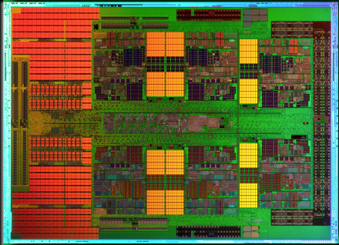
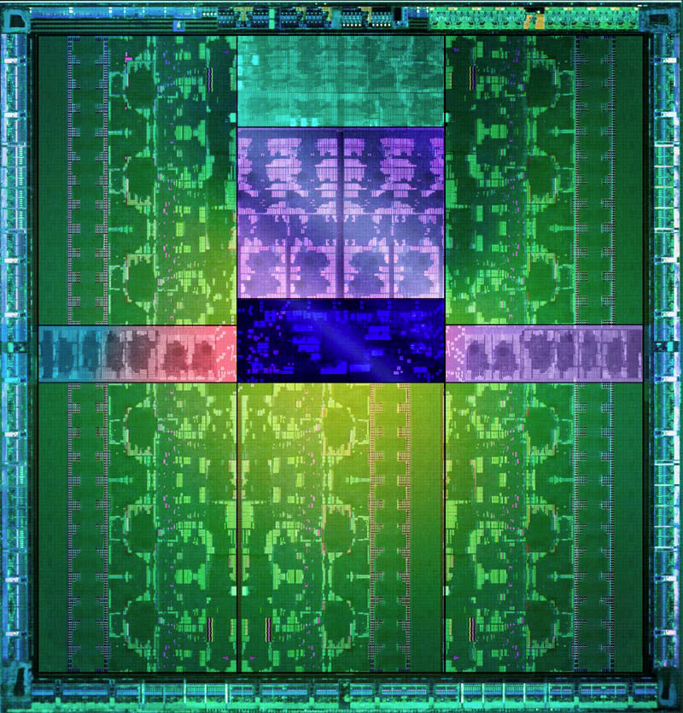
1mm
AMD x86
Full x86 Core
+ Associated Cache
8 cores per die
MPI-Only feasible
1 x86
core
1 Kepler
core
NVIDIA GPU
2,880 cores collected in 15 SMX
Shared PC, Cache, Mem Fetches
Reduced control logic
MPI-Only not feasible
Notes:
What I want to emphasize is the difference between the cores on Cielo and those on accelerators of the type being considered for Trinity.
Each core on Cielo is a fully featured traditional x86 architecture and all the optimizations associated with it.
An accelerator core, in contrast, is significantly stripped down.
You cannot treat them like a symmetric multiprocessor. They are more like SIMD (but not quite as restrictive).
Unlike Cielo, running on Trinity will not simply be “scaling up”.
AMD Magny-Cours. Half of 12 core shown. 8 core used in Cielo.
NVIDIA Kepler GK110. 15 SMX streaming multiprocessor extreme, 192 cores per SMX. 2,880 total cores.

Slide 7
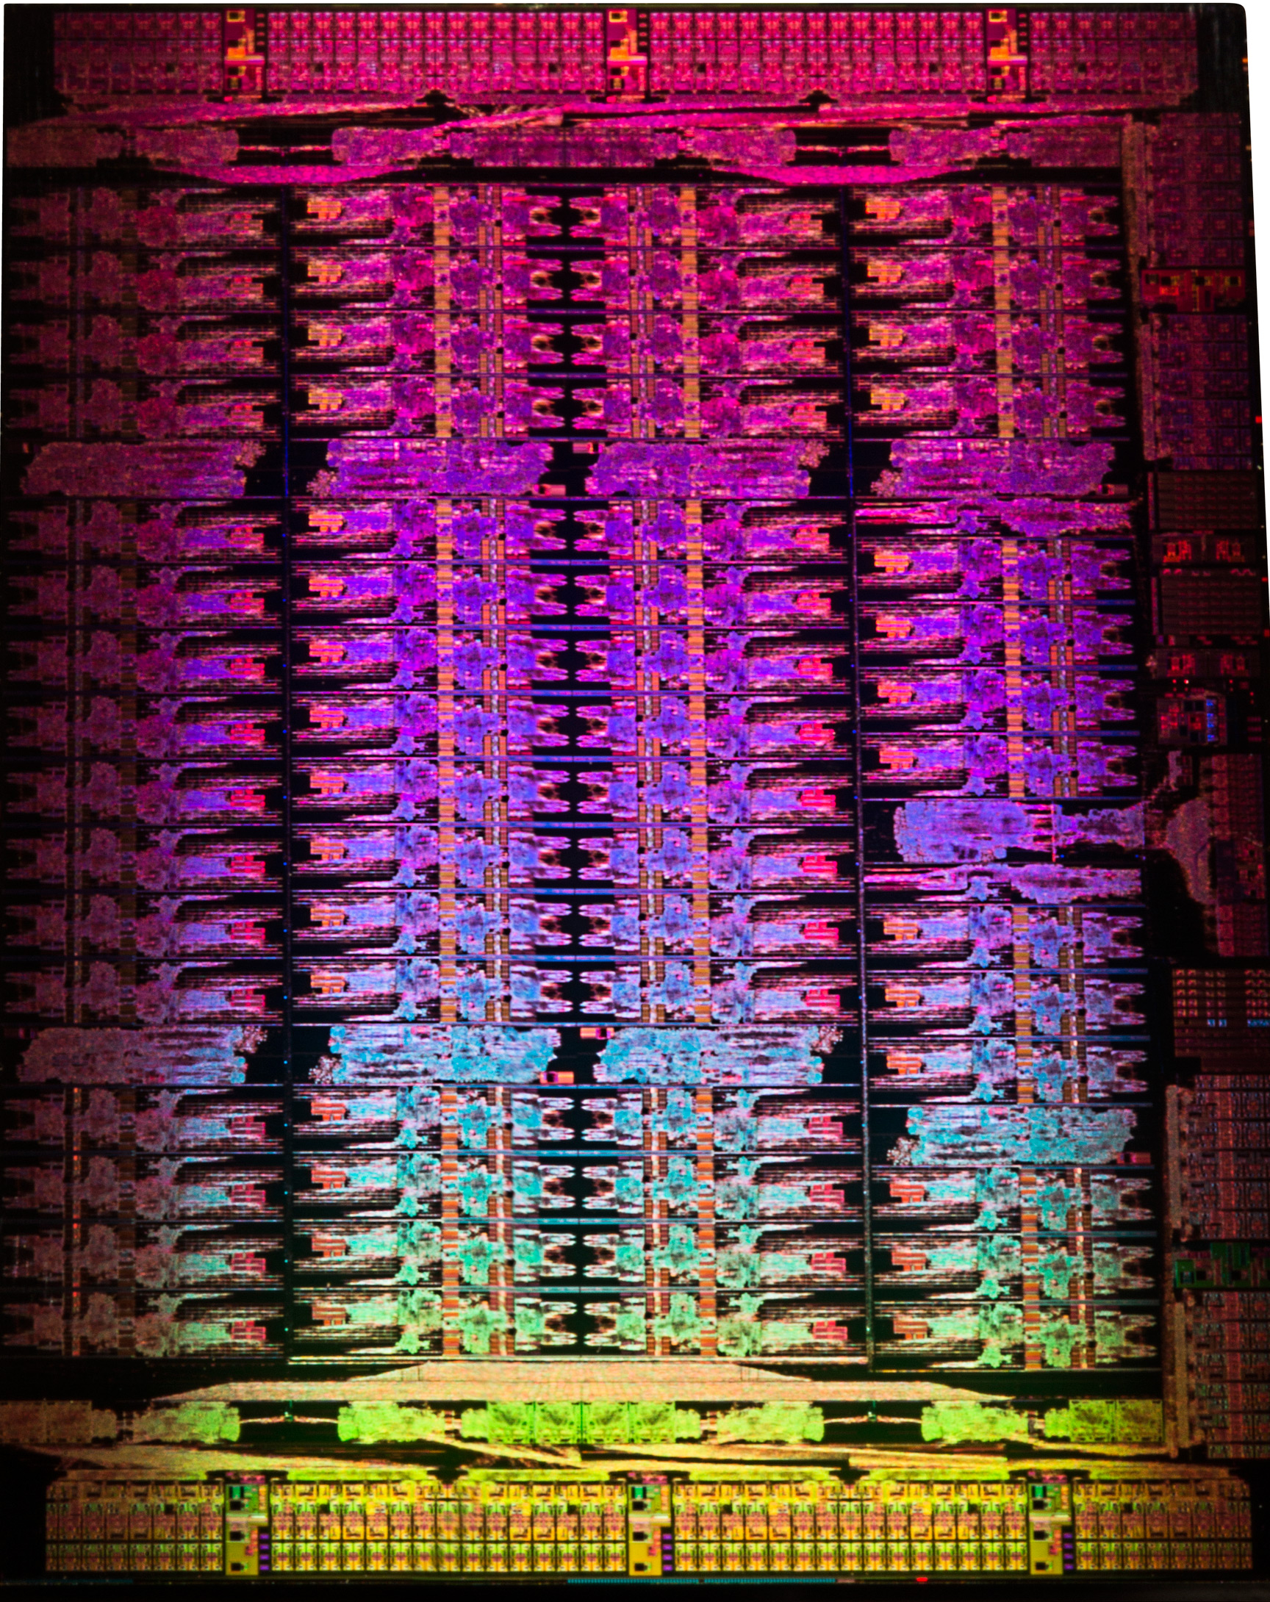
1mm
Cielo
AMD x86
1 x86
core
1 Xeon Phi
core
Full x86 Core
+ Associated Cache
8 cores per die
MPI-Only feasible
Trinity
Intel Xeon Phi
Stripped x86 Cores
62 cores per die
+ 4x hyperthreading
+ 512bit/16 float wide vector ops
Notes:
What I want to emphasize is the difference between the cores on Cielo and those on accelerators of the type being considered for Trinity.
Each core on Cielo is a fully featured traditional x86 architecture and all the optimizations associated with it.
An accelerator core, in contrast, is significantly stripped down.
You cannot treat them like a symmetric multiprocessor. They are more like SIMD (but not quite as restrictive).
Unlike Cielo, running on Trinity will not simply be “scaling up”.
AMD Magny-Cours. Half of 12 core shown. 8 core used in Cielo.
Intel Xeon Phi 3100 family. 61 (?) cores with 4x hyperthreading.
Image assuming die size of about 700mm^2. Guess comes from http://semiaccurate.com/2013/04/04/why-is-intel-so-secretive-about-phis-die/

Slide 8
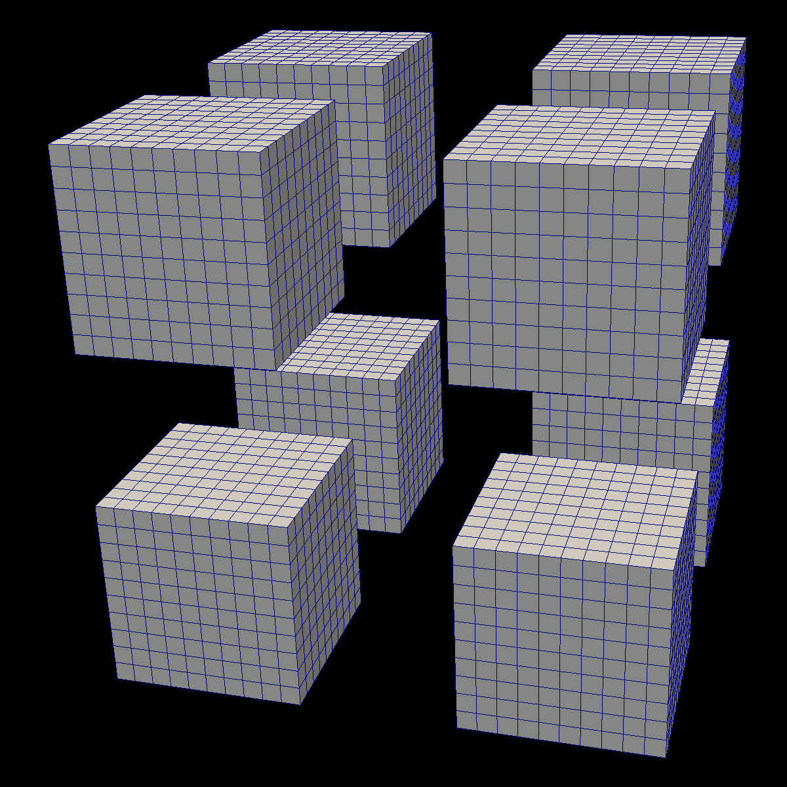
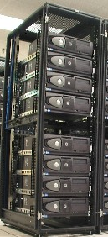
Inter-Node
Parallelism

Slide 9
Inter-Node
Parallelism
Intra-Node
Parallelism

Slide 10


Inter-Node
Parallelism
DIY
Intra-Node
Parallelism

Slide 11




http://m.vtk.org

Slide 12
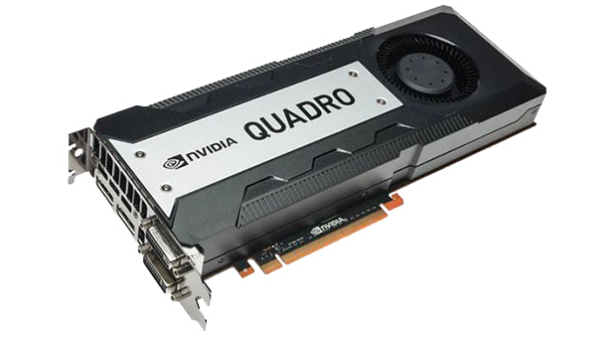
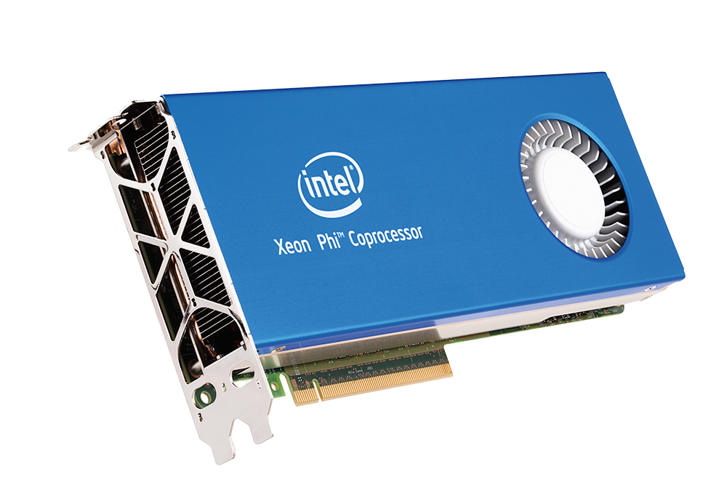
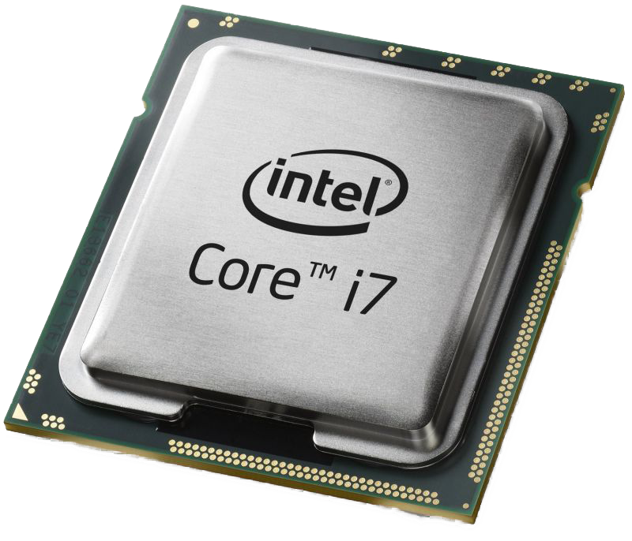
How Many Architectures to Support?
GPU (NVIDIA)
CPU/MIC
Sub-architectures:
Fermi, Kepler, Maxwell
Multiple Memory Types:
Global, shared, constant, texture
Memory Amount: Up to 12 GB
1000s of threads
Grids, blocks, and warps
Mulple ISAs:
Vector unit widths: 2,4,8 / 16
Single Memory Type
Except when not (cache, HSM)
Larger Memory Size
Up to 60/260 threads
No explicit organization

Slide 13
Performance Portability
Architecture
CPU
GPU
MIC
???
A
B
C
D
E
F
Algorithm

Slide 14
Performance Portability
Backend
CPU
GPU
MIC
???
VTK-m
A
B
C
D
E
F
Algorithm

Slide 15
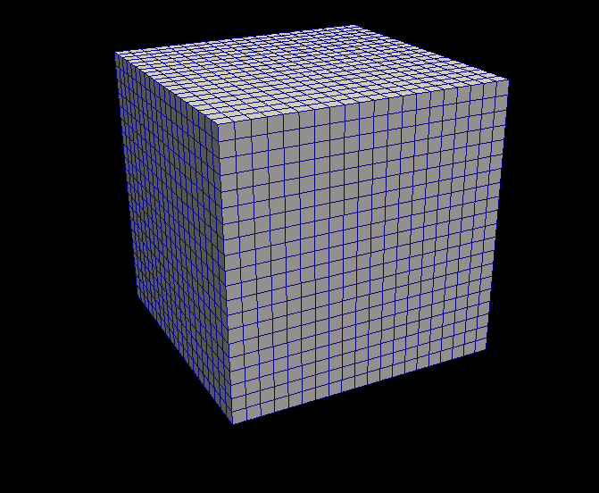
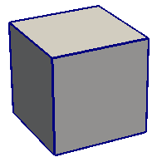
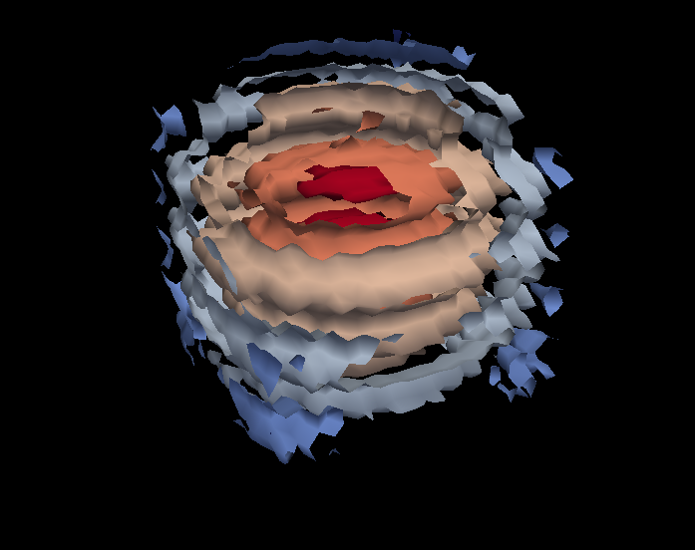
VTK-m Framework
Control Environment
Grid Topology
Array Handle
Invoke
Execution Environment
Cell Operations
Field Operations
Basic Math
Make Cells
Device Adapter
Allocate
Transfer
Schedule
Sort
…
Worklet

Slide 16
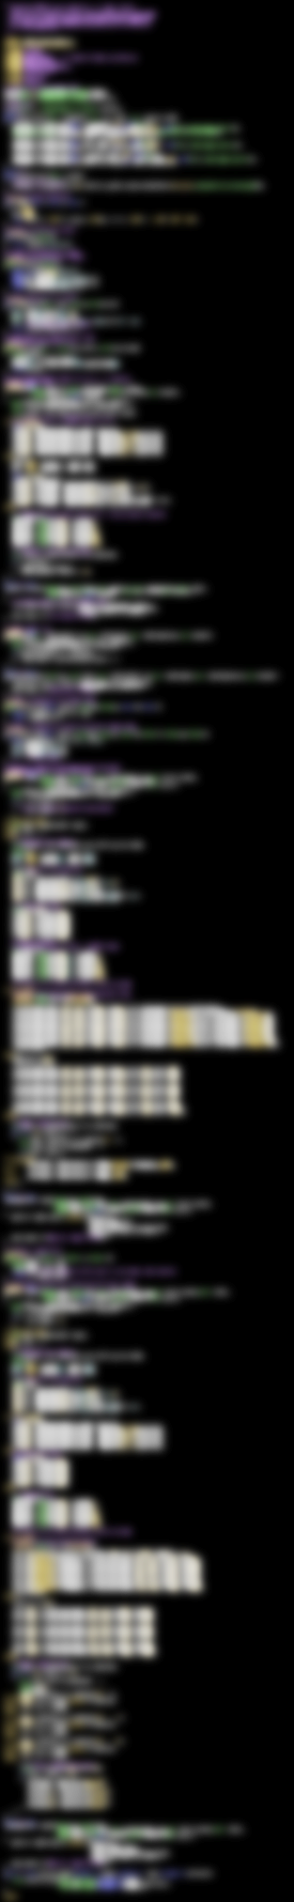
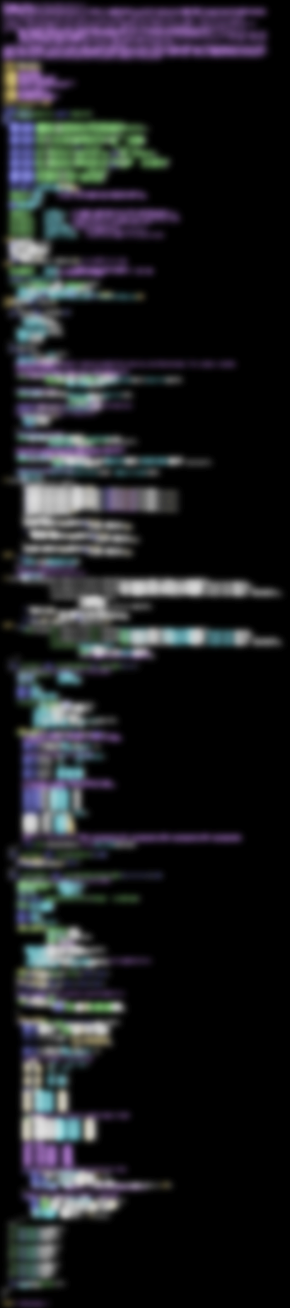

VTK-m
283 Lines
PISTON
505 Lines
CUDA SDK
561 Lines
Notes:
The source code of Marching Cubes in three different packages. Case tables removed (all essentially the same).
CUDA SDK: marchingCubes_kernel.cu
PISTON: marching_cube.h (tables removed)
VTK-m: IsosurfaceUniformGrid.h

Slide 17
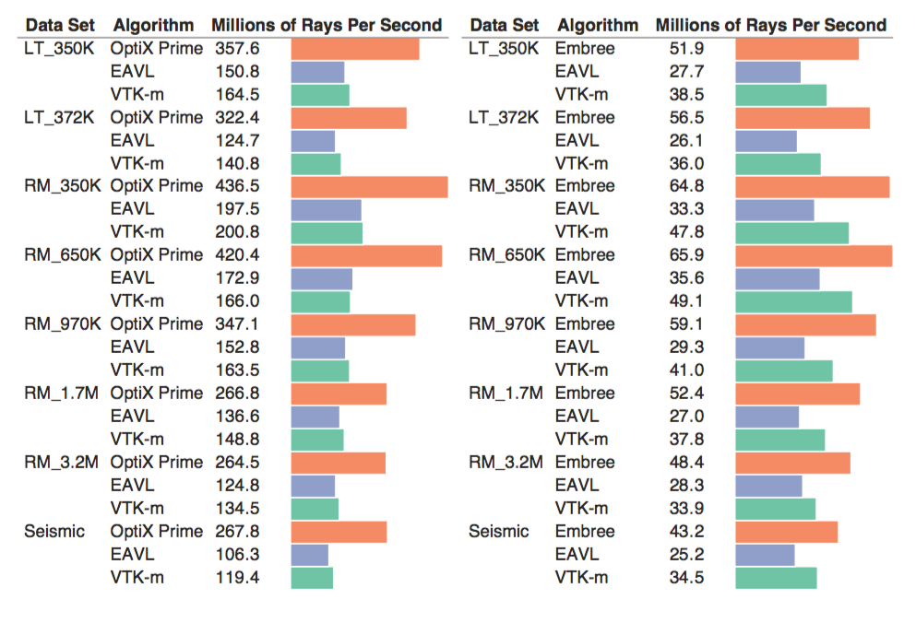
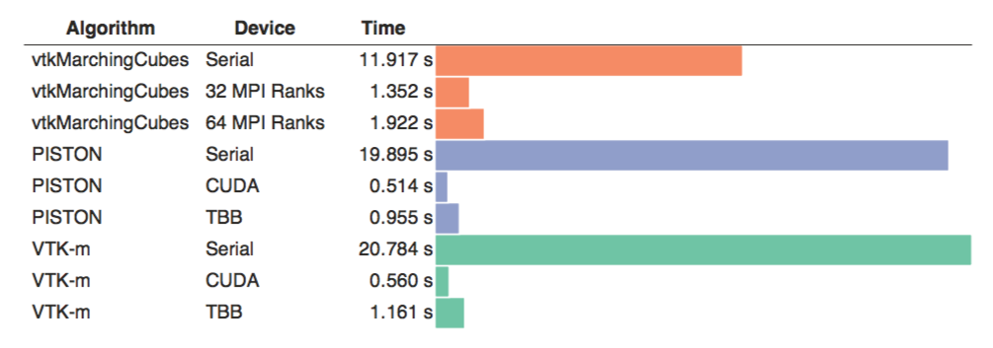
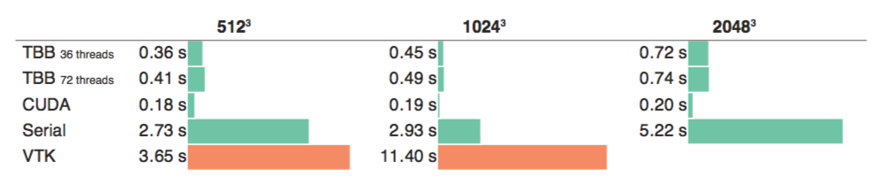
Rendering
Marching Cubes
Surface Simplification

Slide 18

VTK-m is separate from VTK
Algorithm

Slide 19
VTK-m is separate from VTK
Algorithm
Simulation

Slide 20

VTK-m is not a replacement for VTK
Algorithm
Filter
Simulation

Slide 21
Reader
Filter
Algorithm
Filter
Simulation
Filter
Rendering

Slide 22
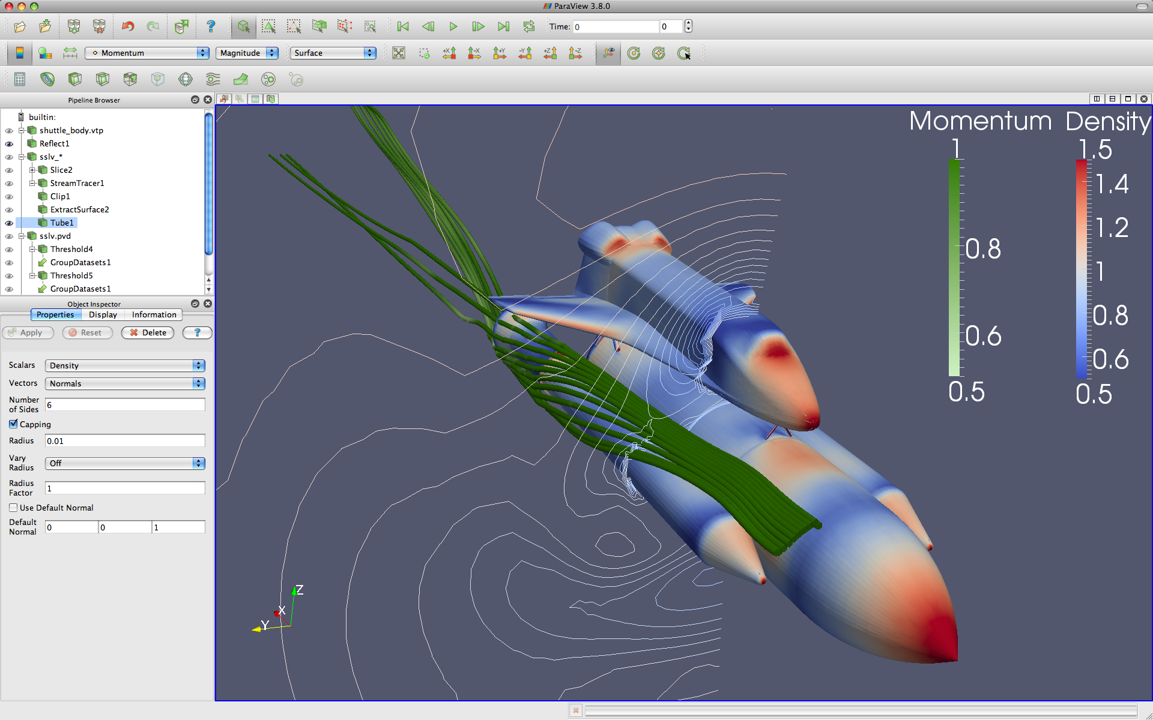
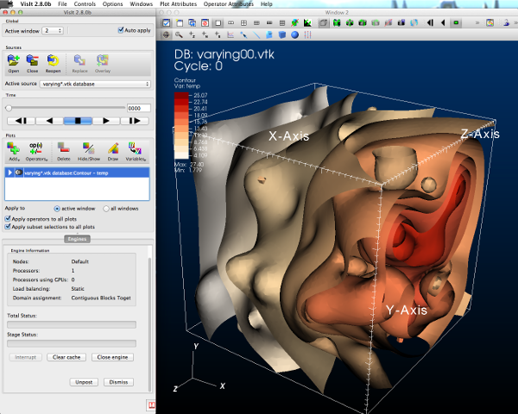

Reader
Filter
Algorithm
Filter
Simulation
Filter
Rendering

Slide 23
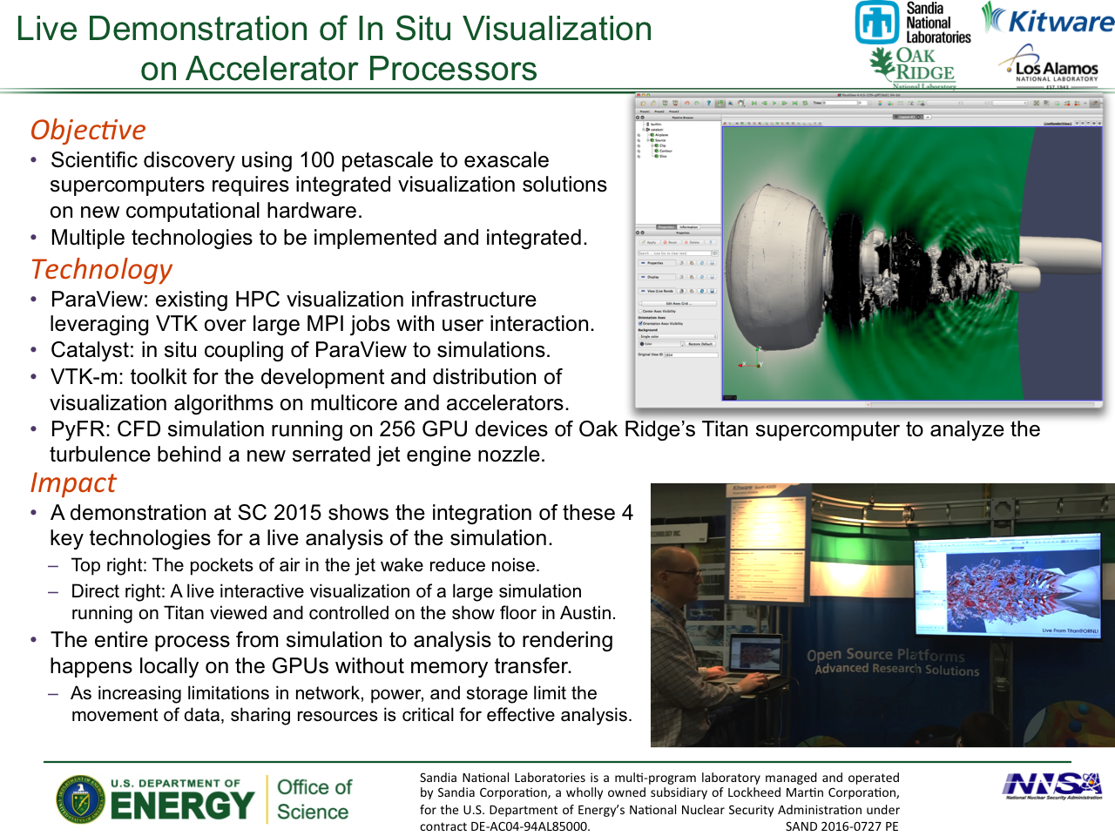

Slide 24
Acknowledgements
This material is based upon work supported by the U.S. Department of Energy, Office of Science, Office of Advanced Scientific Computing Research, under Award Numbers 10-014707, 12-015215, and 14-017566.
Sandia National Laboratories is a multi-program laboratory managed and operated by Sandia Corporation, a wholly owned subsidiary of Lockheed Martin Corporation, for the U.S. Department of Energy’s National Nuclear Security Administration under contract DE-AC04-94AL85000.
Lots of credit goes out to all our collaborators:
Chris Sewell, Jeremy Meredith, David Pugmire, Berk Geveci, Robert Maynard, Hank Childs, and many others.
http://m.vtk.org

Slide 25

Abstracts due June 17
Papers due June 24

Slide 26
Investment in ParaView (Lines of Code)
2.8M

Slide 27
Investment in ParaView (Lines of Code)
2.8M
Unreal Game Engine 3
2M
Windows 3.1
3M

Slide 28
Investment in ParaView (Lines of Code)
2.8M
1.7M
Unreal Game Engine 3
2M
Windows 3.1
3M

Slide 29
Investment in ParaView (Lines of Code)
2.8M
1.7M
VTK
Filters
325K
Unreal Game Engine 3
2M
Windows 3.1
3M

Slide 30
Investment in ParaView (Lines of Code)
2.8M
1.7M
VTK
Filters
325K
480 Independent Filters
Can be updated incrementally
Unreal Game Engine 3
2M
Windows 3.1
3M

Slide 31
Investment in ParaView (Lines of Code)
2.8M
1.7M
VTK
Filters
325K
480 Independent Filters
Can be updated incrementally
Unreal Game Engine 3
2M
Windows 3.1
3M

Slide 32
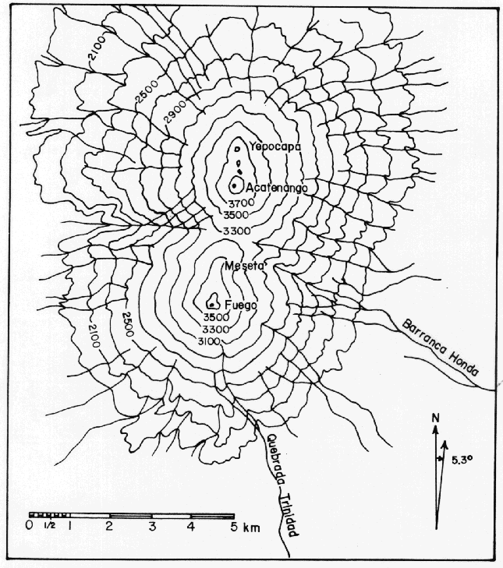
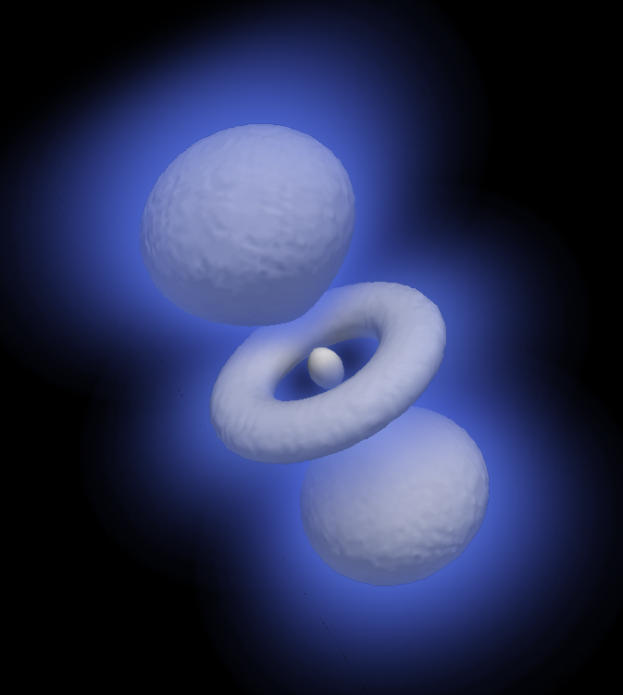
Example Algorithm: Contours
Notes:
Image: Fuego Volcano, Guatemala
Source: National Geographical Institute of Guatemala
Image: Special probability function of electrons in hydrogen atom.

Slide 34
4.2
-1.2
1.0
-3.5

Slide 35
4.2
0
-1.2
1.0
0
-3.5

Slide 36
4.2
0
-1.2
1.0
0
-3.5

Slide 39
?

Slide 40
0
1
1
1
1
2
1
1
0
1
1
1

Slide 41
+0
+1
+1
+1
+1
+2
+1
+1
+0
+1
+1
+1
0
0
1
2
3
4
6
7
8
8
9
10
Total: 11

